Slide 1
12 Months
Directional Roadmap - 2020
Christian Thorsrud
Director of Product
May 2020

Slide 2

How to create engaging customer dialogues
…in a world in constant and rapid change

Slide 3









The journey towards Omni-channel
Communication in all channels, using the same interface and the same algorithm
360°view of customers and interactions
Seamless integration between contact centre and CRM

Slide 4





Puzzel focus areas going forward
Voice
Chat
Social
Email
SMS
Omni-channel
Channels (live agents)
Self-service
Voice, chat, email, social media, sms, e-task
Human interaction
Real-time and non-real-time
Proactive customer service
Knowledge base
Chat enhancements
Chat bots

Slide 5
Roadmap end 2020
Further omni channel enhancements
Further develop Agent Assist application to support agents
Enable scheduling of E-task from internal systems to agents
Enhanced end user WebChat application
Smaller changes and improvements based on customer and partner feedback
Admin and Supervisor
Administration of Agent Knowledgebase
Extended self service capabilities and partner support
Smaller changes and improvements based on customer and partner feedback
Bot/AI
Add Agent Knowledge base capabilities to further support AI analyses
Further develop analytics capabilities on existing voice and textual interactions
Further improve Chatbot capabilities
Integrations &
Connected Cloud
Microsoft Teams integration
Strengthen and deepen standardized CRM integrations
Onboard more integrated apps onto Puzzel Marketplace

Slide 6

MS Teams integration
We are planning to integrate to MS Teams in the following areas
  Search and Presence
  Logon with Teams for voice
  Teams messenger inside the Agent Application
API’s still in beta
  Microsoft API’s are still in an early phase, and most of it running in beta
  We are cooperating closely with Microsoft on the progress
Search and presence integration will be launched in our June 2020 release
  Search for contacts and see their Teams presence
  The Presence API are still in beta and with some limitations
  Puzzel will do updates alongside Microsoft

Slide 7
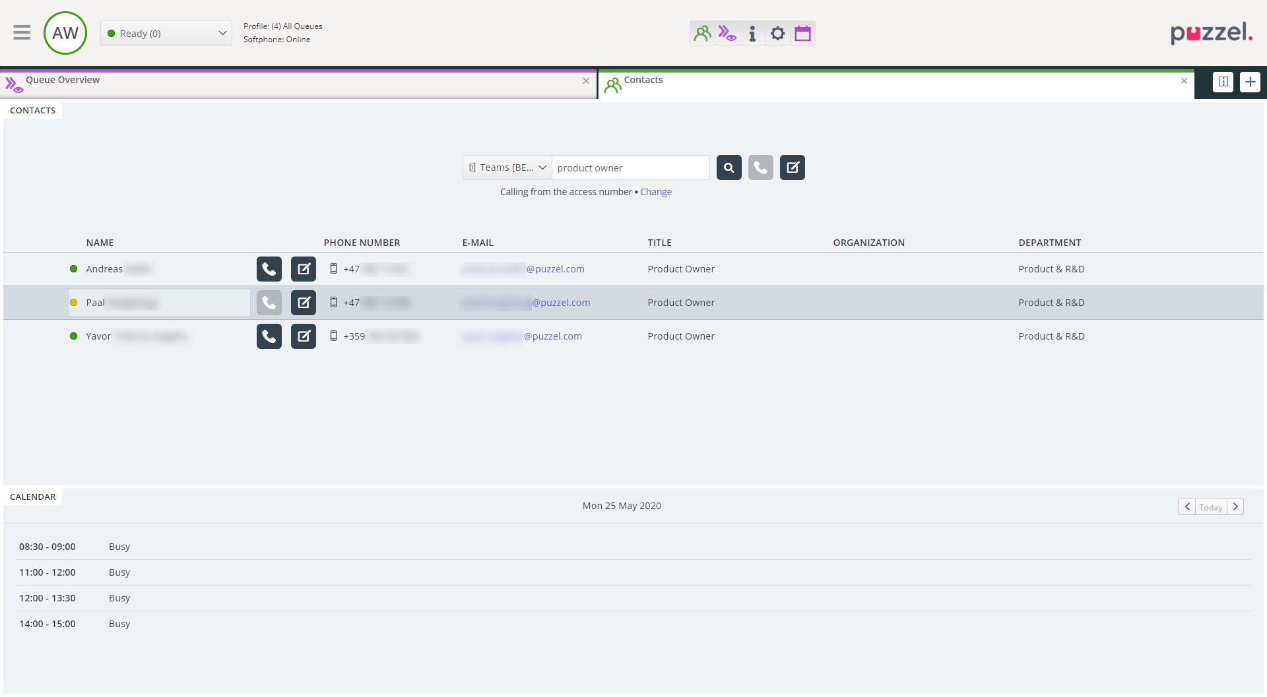
MS Teams integration – search and presence

Slide 8
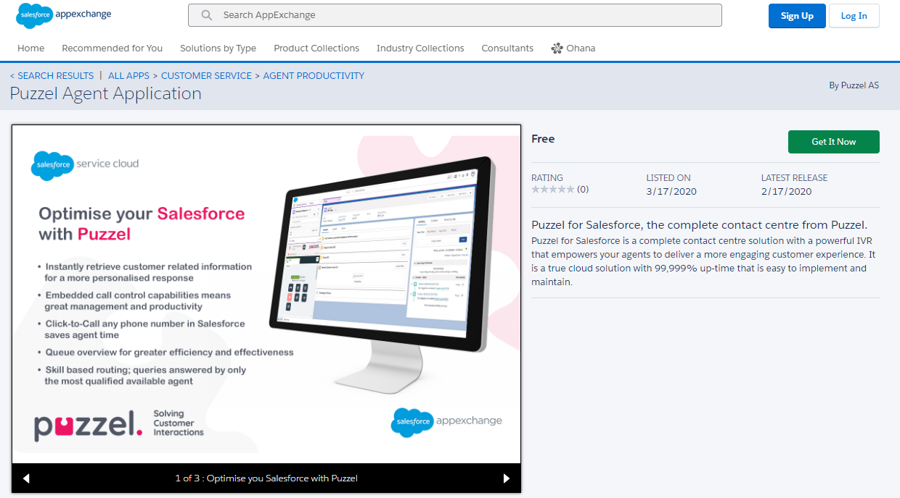
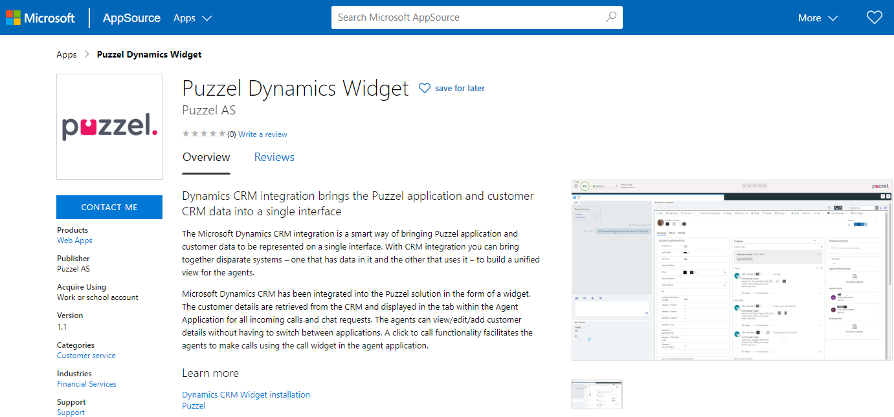
CRM integration - enhancements
Dynamics embedded in Puzzel (widget)
Puzzel embedded in Salesforce

Slide 9
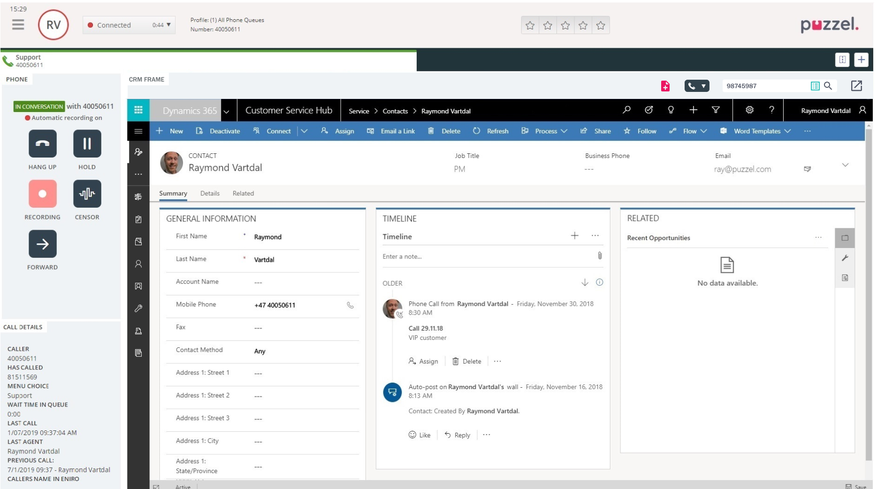
CRM integration - enhancements
Dynamics embedded in Puzzel (widget)

Slide 10


CRM integrations - improvements
MS Dynamics improvements – April 2020 release
  UI changes in the widget
  Viewer for recordings and chatlogs in Dynamics
  Support for emails and etasks
  Custom filters for contacts and account
  Customized list view for contacts and account
  Customized search for entities other than contacts and accounts
  Navbar turned on when popping out to new tab
  Log call when call completed
SSO on Salesforce – June 2020 release

Slide 11
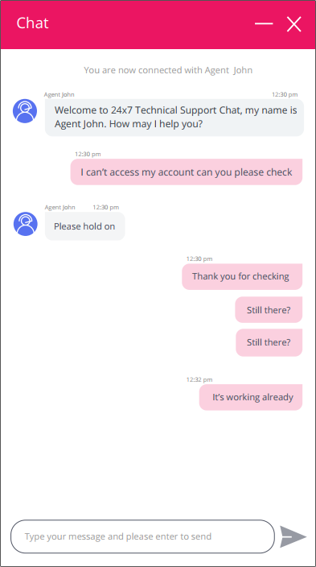
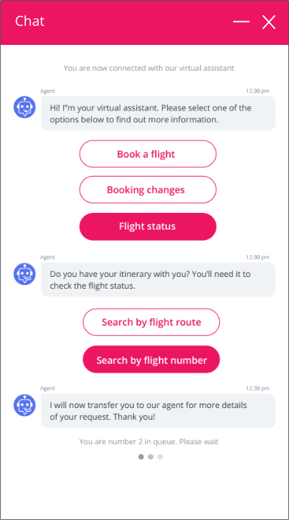
New End-user chat
Developing a new and future proof web chat solution
  End-user web chat
  End-user Knowledgebase
  WebRTC
First version ready early Q4 2020

Slide 12
Improved self-service in Admin portal
The goal is to make it easier to set up and manage a Puzzel solution for partners and customers
Functionality to be released:
  Creates system queue and skill from Services – April 2020 release
  Partner access to Users-Products and Administration – June 2020 release
Further focus areas:
  Number handling
  Wizards for setup
  CFT improvements
Q4 2020 - 2021

Slide 13


Answer / hang-up on Jabra headset – April 2020 release

Slide 14
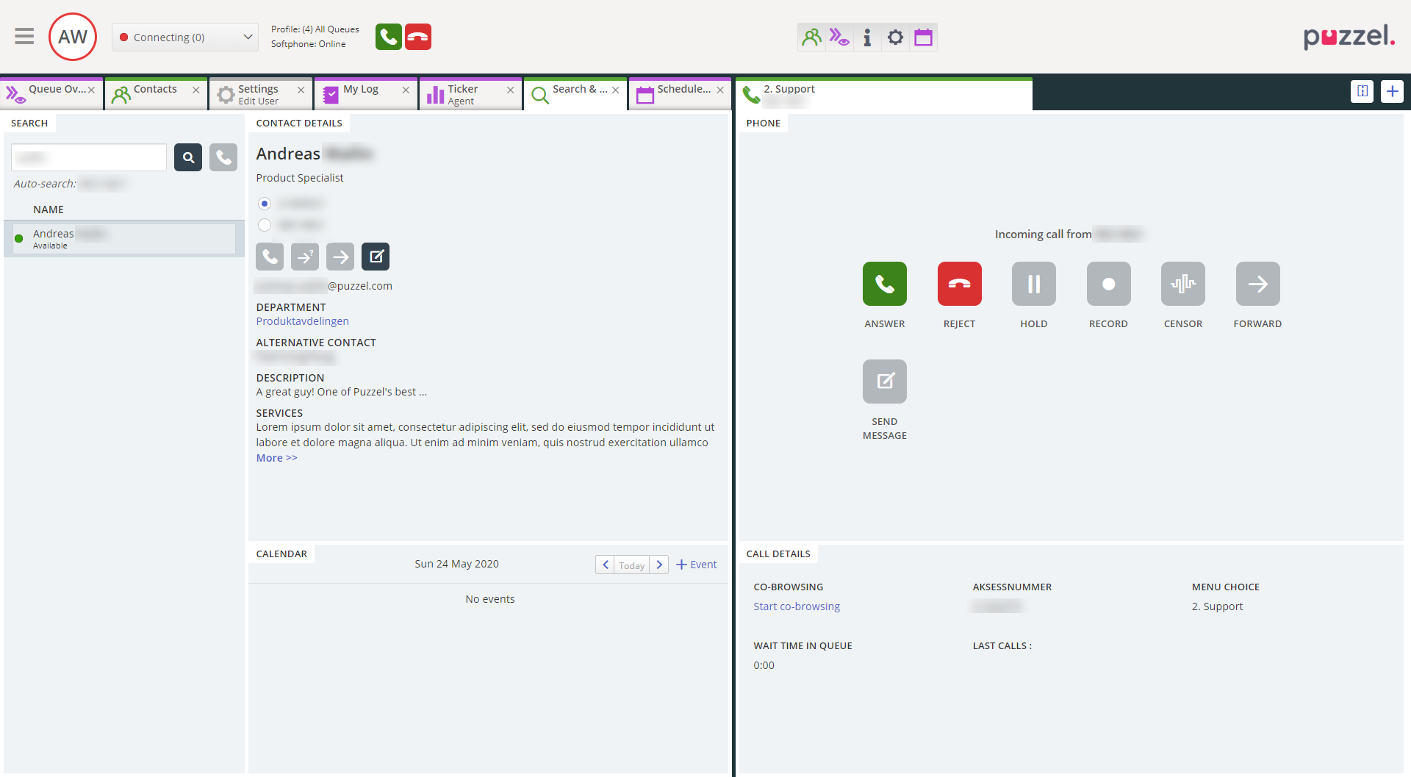
Switchboard widget – June 2020 release

Slide 15

Migration to Azure public cloud

Slide 16
Roadmap end 2020
Further omni channel enhancements
Further develop Agent Assist application to support agents
Enable scheduling of E-task from internal systems to agents
Enhanced end user WebChat application
Smaller changes and improvements based on customer and partner feedback
Admin and Supervisor
Administration of Agent Knowledgebase
Extended self service capabilities and partner support
Smaller changes and improvements based on customer and partner feedback
Bot/AI
Add Agent Knowledge base capabilities to further support AI analyses
Further develop analytics capabilities on existing voice and textual interactions
Further improve Chatbot capabilities
Integrations &
Connected Cloud
Microsoft Teams integration
Strengthen and deepen standardized CRM integrations
Onboard more integrated apps onto Puzzel Marketplace

Slide 17
Thank you!

