Slide 1
CORE CORPORATE SLIDES
Presenters name

Slide 2
Alternative section pages Click on ‘layout’ in the top menu for more options

Slide 3
Opening/Closing slides
Guidelines
The following slides are examples of how you can structure your opening/closing slides.
If you would like to use profile pictures of your fellow colleagues, the Puzzeler picture library can be accessed through Sharepoint here.
If you like to create a customised design for your opening slide, please contact Marketing and we’ll help source a suitable illustration/image.

Slide 4









Slide 5





Title
Date YEAR

Slide 6



Title
Date YEAR

Slide 7


Presentation title

Slide 8
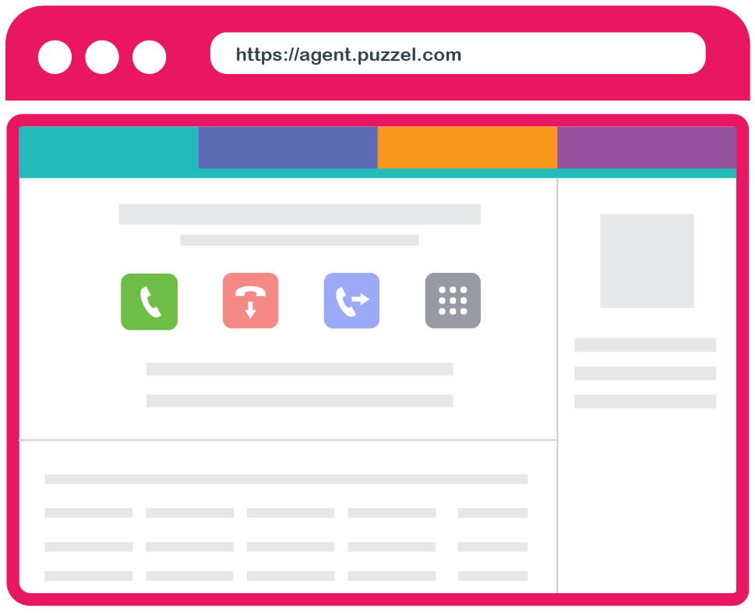
New Agent Application
Presenter
Date

Slide 9
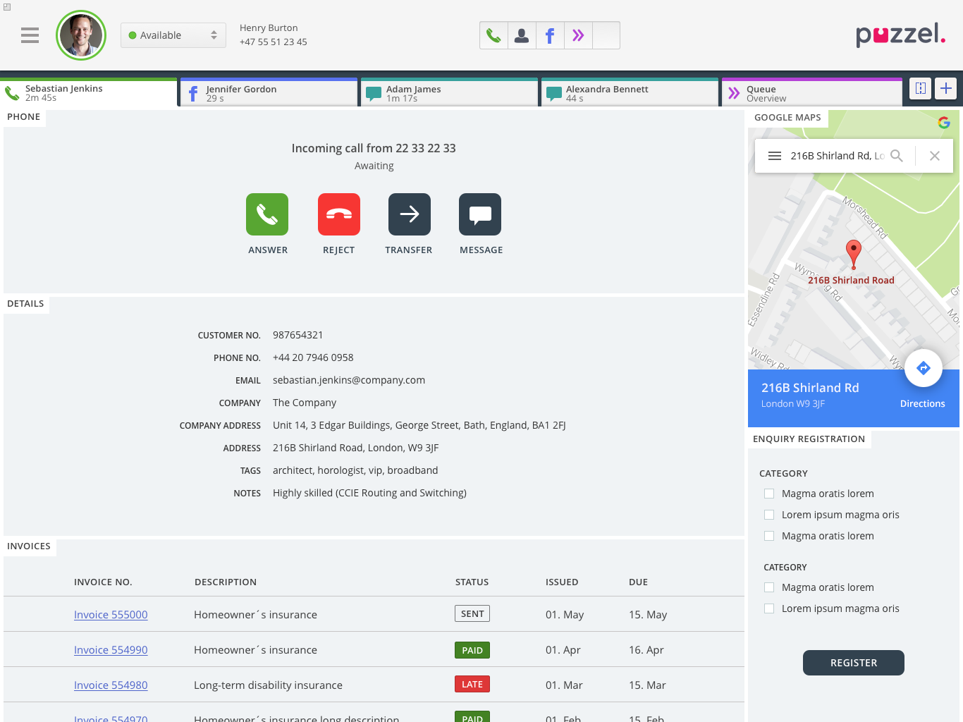

New Agent Application
Presenter
Date

Slide 10


Thanks!
Presenters Name – Title +47 999 99 999 / name.name@puzzel.com

Slide 11


Thanks!
Presenters Name – Title +47 999 99 999 / name.name@puzzel.com

Slide 12
Thanks!
Presenters Name – Title +47 999 99 999 / name.name@puzzel.com
/Puzzelsolutions
/company/puzzel-solving-customer-interactions/

Slide 13






Quick Overview
Topic 1
Topic 2
Topic 3
Topic 4
Next Steps

Slide 14

Quick Overview
Topic 1
Topic 2
Topic 3
Topic 4
Next Steps

Slide 15









Quick Overview
Cloud Multi Channel Contact centre
Puzzel Pay
Integrations & Partners
Next Generation
Next Steps
New Steps
New Generation

Slide 16
Presenter introduction slides
Guidelines
The following slides are examples of how profile pictures can be used when introducing a presenter.
When adding a new profile picture to the slides, the Puzzeler picture library can be accessed through Sharepoint here.
If you would like to feature external presenters on your slide, please ensure you source a high resolution photo and that you crop the image according to the template.

Slide 17

Presenters name
Title

Slide 18

Presenters name
Title
Workplace name
[Add a logo here]

Slide 19
Puzzeler slides
Guidelines
The following slides are examples of how pictures of the Puzzelers can be used in presentations.
When adding a new profile picture to the slides, the Puzzeler picture library can be accessed through Sharepoint here.

Slide 20


Insert welcome text

Slide 21
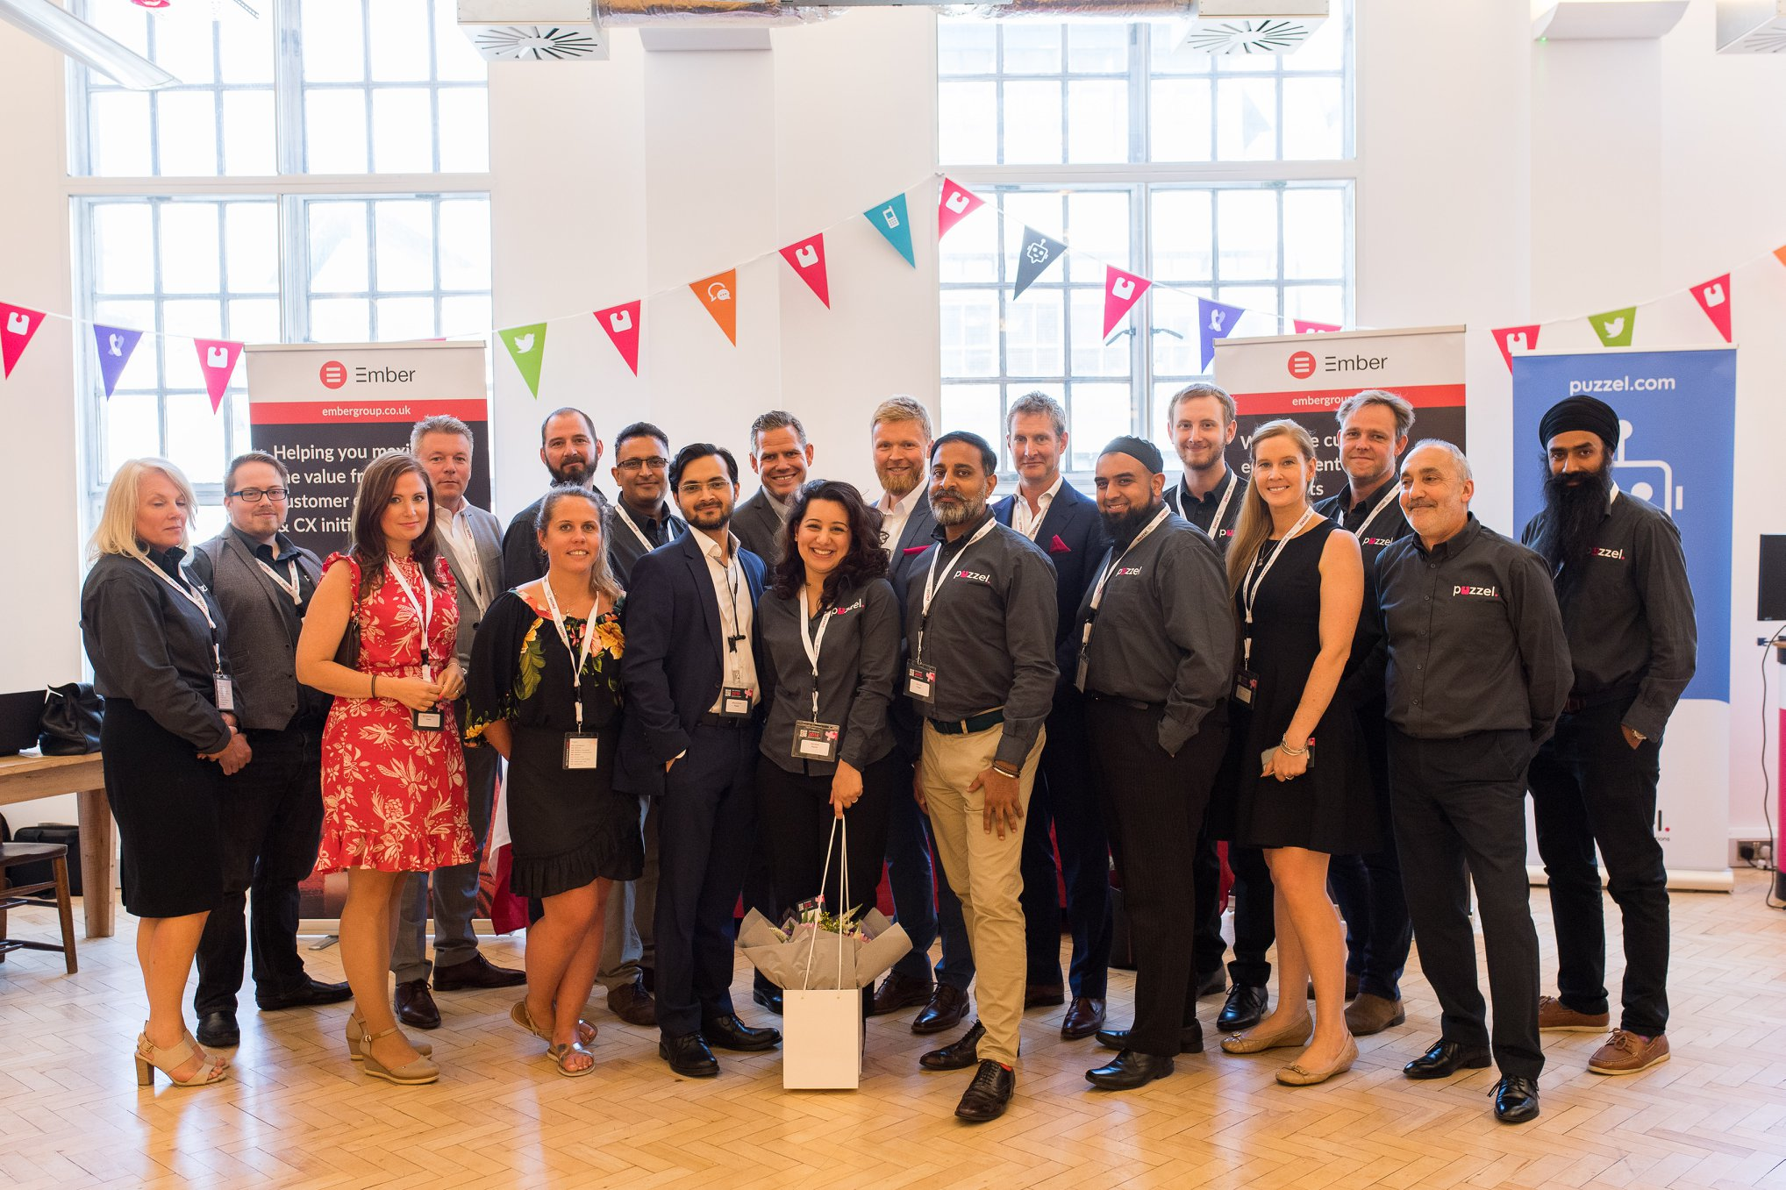





Slide 22




Slide 23

Loosen up!​
Go grab a drink and snacks​

Slide 24

Hope you enjoyed so far​
Go grab a drink and snacks​

Slide 25
Core Company Overview slides

Slide 26
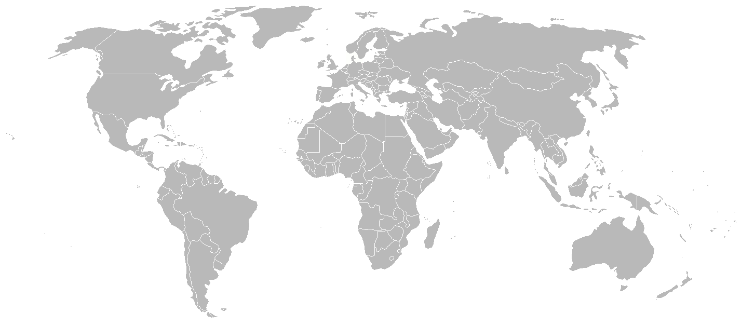








Leading European Contact Centre (CCaaS) Provider
Sweden
Norway
Danmark
Finland
UK
25%
7
+3k
14
+22k
Growth
Offices
Agent/cust
Partners
Agents
Bulgaria

Slide 27
Puzzel in UK / Europe
UK
70%
30%
+35%
20 staff
Direct
Partners
SW Growth
5 Sales
Utility, Government, Retail, Housing, Travel, Services, BPO, Financial

Slide 28
Company Overview
Highlights
European Focus and regions
Native multi-tenant platform based on own IP
More than 20 years cloud experience
99,99% availability - Secure and scalable
Group Cloud revenue 35 MEUR
Nordics
Western Europe
Agents in more than 25 countries
7 Office locations
Operating Metrics
Strong and international focused team
> 22,000 Agents, > 900 customers across 40 countries
Customers with 20 - 2000 agents
25% growth
Fourth consecutive year as “Challenger” in Gartner’s Magic Quadrant for Contact Centre as a Service, Western Europe, further improved from previous years
160 employees
23 nationalities
Strong and focused performance culture
Herkules PE – 95% Shareholder
Social responsibilities

Slide 29
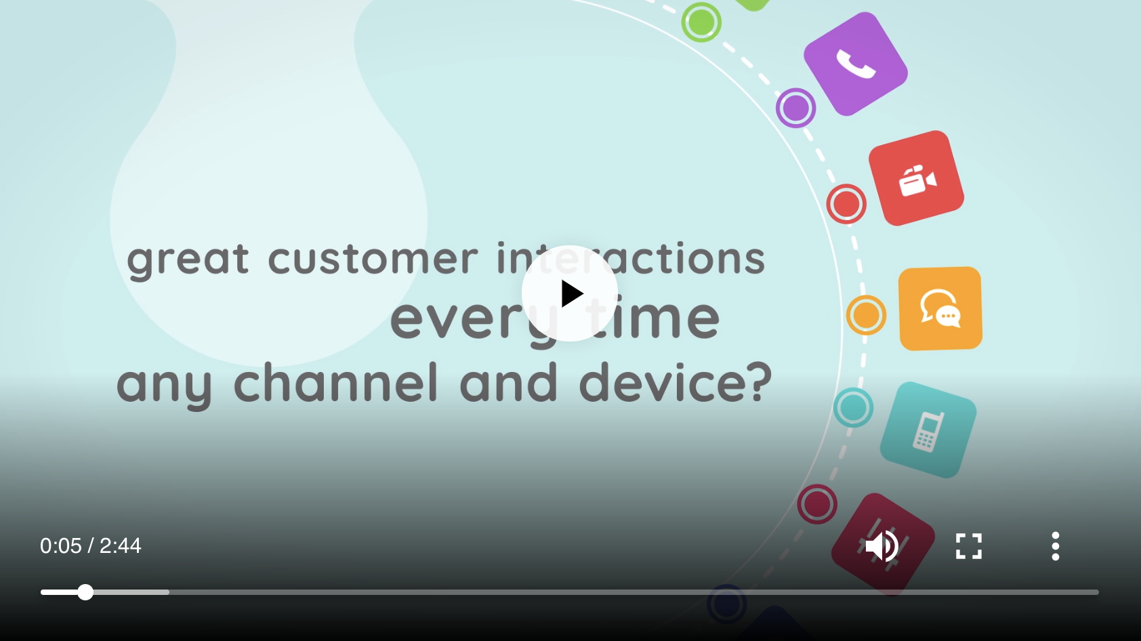
Placeholder Puzzel animation
You can access the language specific animations here:
Puzzel Animation Videoes

Slide 30



Puzzel Timeline
Gartner
1998
1999
2000
2001
2002
2003
2004
2005
2006
2007
2008
2009
2010
2011
2012
2013
2014
2015
2016
2017
2018
Voice Contact Centre
Multi-Channel
Omni Channel

Slide 31
Key Milestones
2017
Demerged and rebranded to Puzzel
1998
Puzzel established as Consorte Group offering cloud based communication solutions
2008
Delisted and acquired by Norvestor Equity
2001
Listed on the Oslo Stock Exchange (OSE)
2010
Acquired by Herkules Capital
2012
Initiate growth initiative in UK
2015
Recognized by Gartner in MQ
2018
Won Largest European CCaaaS deal If
1998
1999
2000
2001
2002
2003
2004
2005
2006
2007
2008
2009
2010
2011
2012
2013
2014
2015
2016
2017
2018
2010
Increased investments in CCaaS offering
2009
Merged with Carrot Communications competing Norwegian Cloud based Contact Centre (CCaaS) Vendor
2016
Established office in Bulgaria
2018
Office in Finland
Bots
2001
Expanded business across Scandinavia
2006
Began expansion outside of Scandinavia
2017
Established second office in Bulgaria
2015
2016
2017
2018
Recognized as “Challenger” in Gartner Magic Quadrant
Developed Active/Active Platform to further support uptime
Sales partnership with leading Nordic carrier, Telenor
Launched social media as a channel
>30% CC growth in UK and Sweden
Continued geographic and vertical expansion
Established nearshoring in Sofia, Bulgaria
Launched embedded Softphone capabilities
Awarded the If Insurance contract. Europe’s biggest CCaaS contract with 3,000 agents
Introduced innovative Unified Agent Application with extensive low code integration
Separated from the Systems Integration business unit, and began operations as standalone business
Expanded geographical presence to Finland
Launched new chatbot functions and GDPR compliant solutions
Fourth consecutive year as “Challenger” in Gartner Magic Quadrant, further improved from previous years

Slide 32
Demonstrated ability to maintain growth through innovation and geographical expansions
2015
2016
2017
2018
Recognized as “Challenger” in Gartner Magic Quadrant for CCaaS
Developed Active/Active Platform to further support uptime
Sales partnership with leading Nordic carrier, Telenor
Launched social media as a channel
>30% CC growth in UK and Sweden
Continued geographic and vertical expansion
Established nearshoring in Sofia, Bulgaria
Launched embedded Softphone capabilities
Awarded the If Insurance contract. Europe’s biggest CCaaS contract with 3,000 agents
Introduced innovative Unified Agent Application with extensive low code integration
Separated from the Systems Integration business unit, and began operations as standalone business
Expanded geographical presence to Finland
Launched new chatbot functions and GDPR compliant solutions
Fourth consecutive year as “Challenger” in Gartner Magic Quadrant, further improved from previous years
2010
2011
2012
2013
2014
2015
2016
2017
2018
Acquired by Herkules Capital
Increased investments in CCaaS offering
Initiate growth initiative in UK
Recognized by Gartner in MQ
Demerged and rebranded to Puzzel

Slide 33
A Recognized Leader
Highlights
Puzzel 4 years in a row in the Gartner‘s Magic Quadrant for CCaaS*
Pricing, understanding of business requirements and functional capabilities
Easy to configure advanced omni-channel solutions
Successful execution of rebrand strategy and ability to demonstrate the value of the CCaaS solution
20+
900+
25
4
Years
Experience
Customers
Countries
Continents
Source: *Reference to the 2018 version of the report.

Slide 34
Why We Win?
Self service and 100% multi-tenant
Unified native support for all channels with own IP
Total cost of ownership
Omni-channel
Flexible API and
pre-packaged integrations extends market reach and provides turn-key solutions
Reliable & Secure
Collaboration
99.99% Uptime, fully redundant
Customer success
Marked leading logos, reference stories

Slide 35
Core slides Puzzel Contact Centre

Slide 36









Unified comprehensive offering
Tailored to solve customer interactions
Cloud Contact Centre

Slide 37






Cloud based Contact Centre
Including: Administration Portal
Reporting
Queue Management
Call Flow Tool
User Management
Quality Monitoring
API
Additional Modules
Ticketing
Workforce Management
Speech Analytics
Knowledge base
Payment
Notes:
Bytte bildet med bot

Slide 38
Channels
Puzzel core
Voice
Chat
Social
Email
SMS
Softphone
Outbound dialer
IVR
Recording
Call Back
Multi-device support
Design Flexibility
Survey
Structured Messages
URL Tracking
Facebook
Twitter
WhatsApp
TrustPilot
Advanced Routing
Email System Agnostic
Advanced Routing
Scheduling
CRM Access
MS Exchange Intergration
Shortcode Numbers
Inbound
Outbound
Message Templates
Alphanumeric Originator
Including: Administration Portal
Additonal Modules
Reporting
Queue Management
Call Flow Tool
User Management
Quality Monitoring
API
Ticketing
Workforce Management
Speech Analytics
Knowledge base
Payment

Slide 39



Operations
99,99%
Availability
Puzzel is certified against industry standards:

Slide 40














The world of customer service - bringing all the pieces together
Customers
Customers
Channels
Channels
Agents
Self-Service
Management
Knowledge

Slide 41


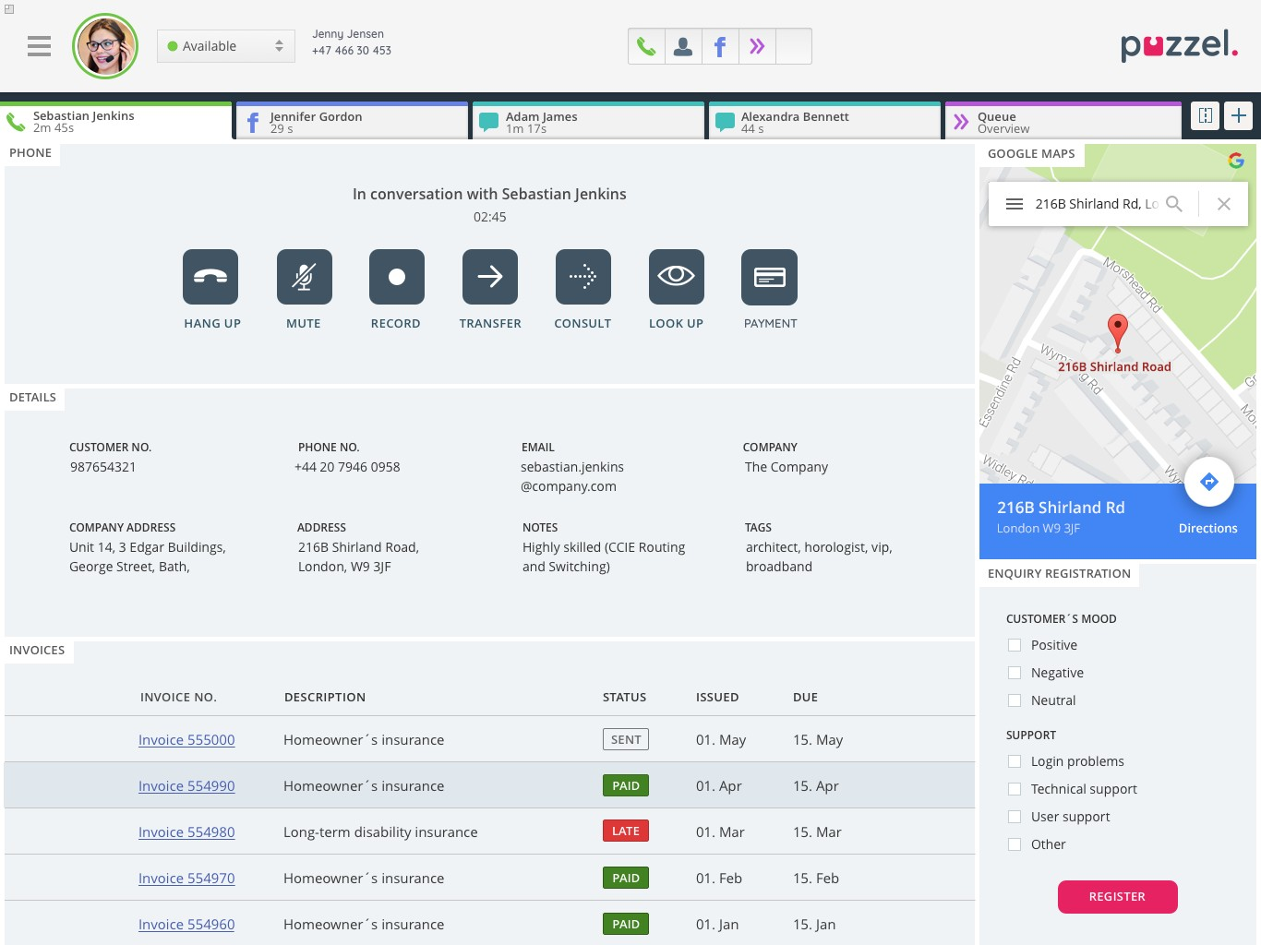




Full suite omni-channel contact centre solution
Flexible agent platform with possibility for customized interface
A powerful low code administration portal
A broad range of channels and application
The customer experience
Contact Centre
Integrations
powerful agent platform
Mobile Messaging
AI
Voice
Chat
Email
Social
SMS
E-task
MS Dynamics
Salesforce
Oracle
Skype 4B
SuperOffice
Mobile Survey
Messaging Gateway
SMS as a channel
Social Messaging
Bots
Conversational Platform
Agent Assist
WFO
Payment
Ticketing
Services
Workforce Mgmt.
Speech Analytics
Performance Mgmt.
Quality Monitoring
In-Call PCI payments
Mobile payments
Case Management
360-view of customer
Knowledge base
Training
Accreditation
Support
Reporting
Queue Management
Call Flow Tool
User Management
Quality Monitoring
API
Administration Portal

Slide 42
Puzzel focus areas going forward
Voice
Chat
Social
Email
SMS
Omni-channel
Channels (live agents)
Self-service
Voice, chat, email, social media, sms
Human interaction
Real-time and non-real-time
Proactive customer service
Knowledge base
Chat enhancements
Chat bots

Slide 43

Goal with an Innovation department
Strengthen Puzzel innovation capability and culture for innovation
Search to find and generate new revenue sources
Make it possible to think outside the box
Focus on innovation on new and around existing products

Slide 44

Simplified innovation process
Idea!
Resets every 6 month
Innovation team
Line organisation
From:
Employees
Customers
Partners
Owners
…….

Slide 45










Puzzel Contact Centre
Bot Frameworks
Conversational Platform
Handover agent
Integrations
Reports
Generic API

Slide 46
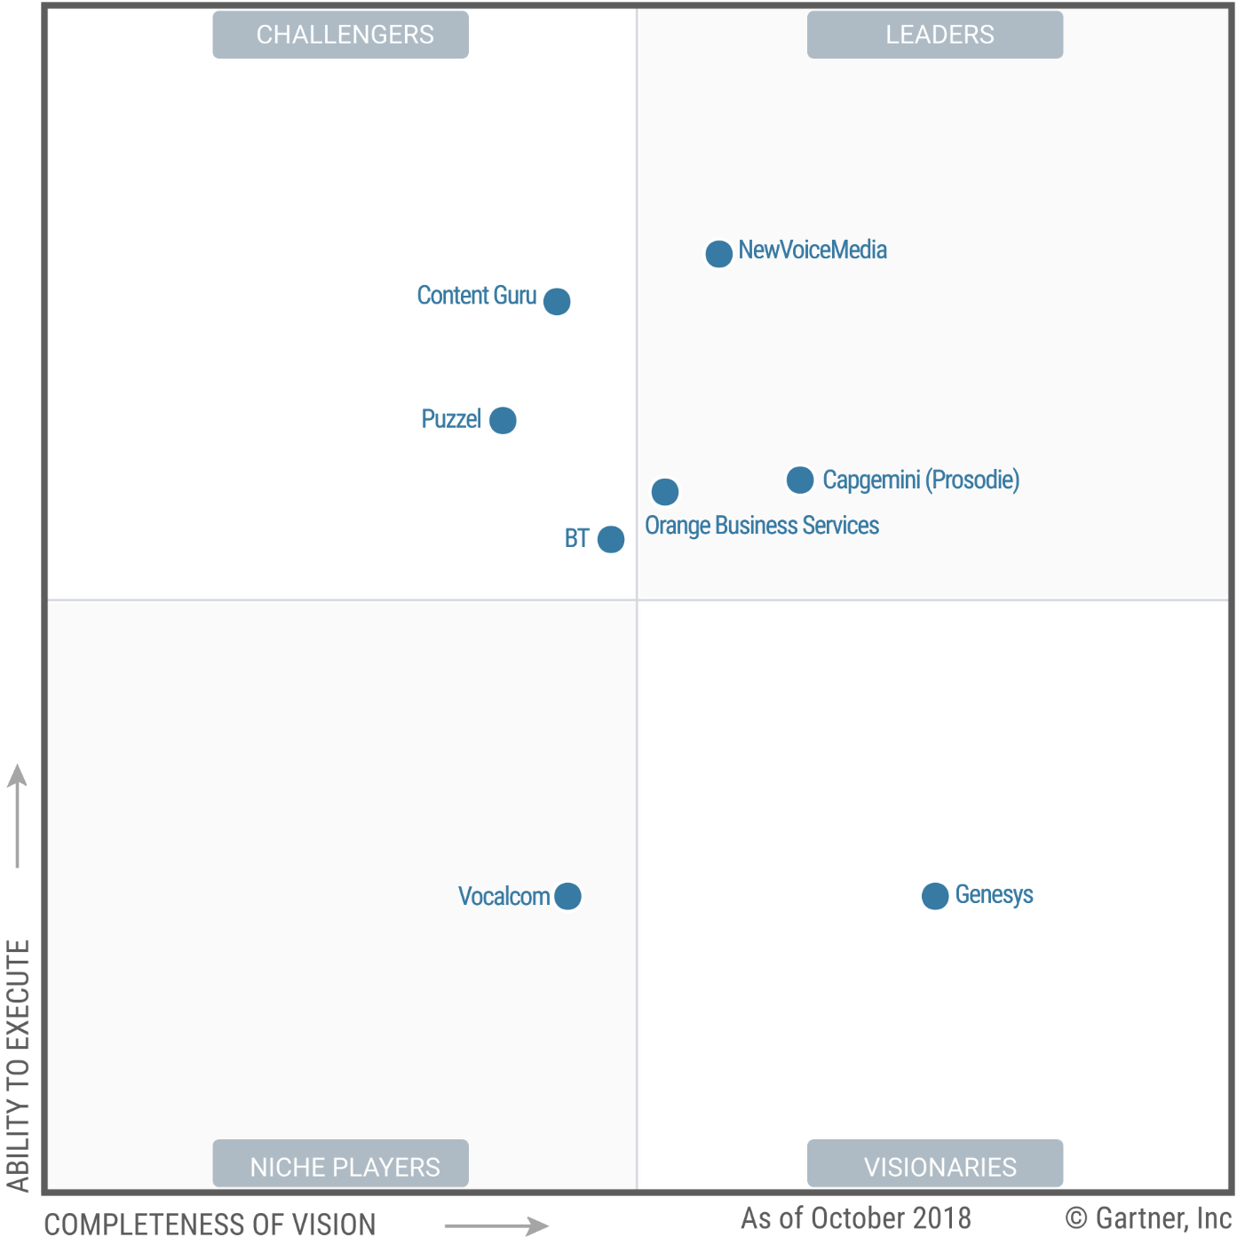

Gartner Magic Quadrant
Magic Quadrant for Contact Centre as a Service, Western Europe & Security Compliance
PCI
Payment Card Industry Standard
ISO 27001
Information Security
ISO 9001 Quality

Slide 47
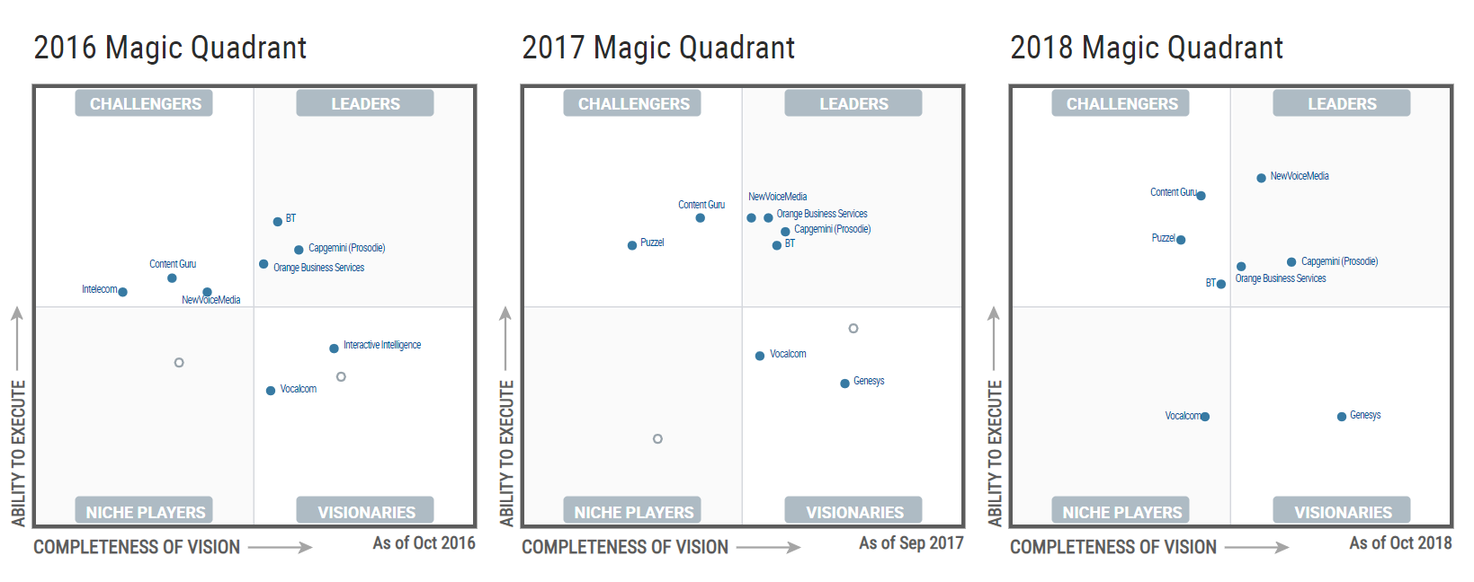
Certified and recognized by Gartner
Magic Quadrant for Contact Centre as a Service, Europe

Slide 48
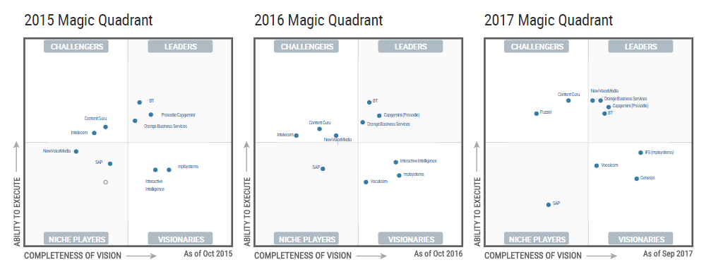
Certified and recognized by Gartner
Magic Quadrant for Contact Centre as a Service, Europe

Slide 49
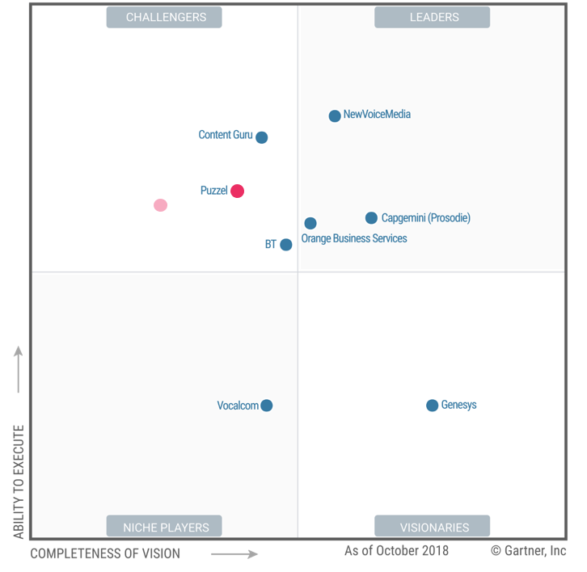
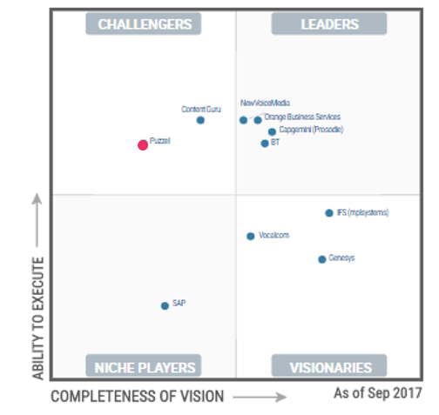
Magic Quadrant details
2018 Magic Quadrant
2017 Magic Quadrant

Slide 50



























Broad and Loyal Global Enterprise Client Base

Slide 51
























NO Customer logos

Slide 52





























DK Customer Logos

Slide 53




















SE customer logos

Slide 54












UK customer logos

Slide 55

UK customer logos - sectors
Utilities
High tech & Business Services
Public sector
Retail

Slide 56



































Bulgaria customer logos

Slide 57























Technology Partners
Resellers
Notes:
Tech
Signicat-
Zendesk-
Microsoft-
Oracle-
SuperOffice-
Touch-
Vipps-
Boost-
Teleopti-
Reseller
Sulono

Slide 58
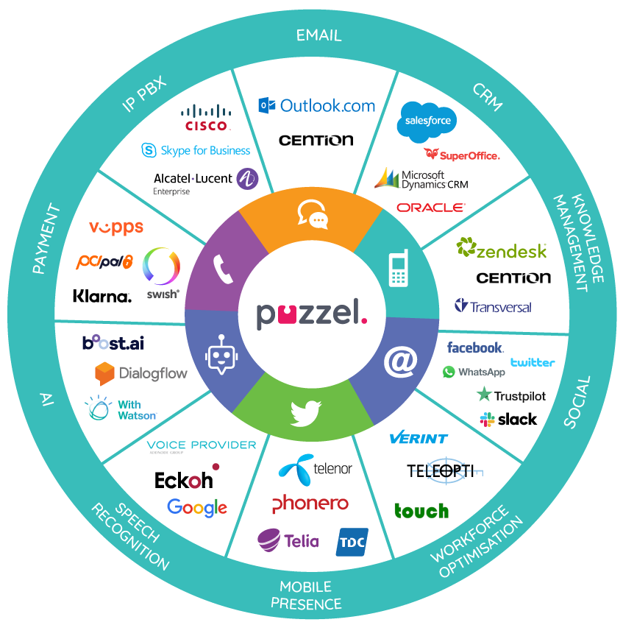
Robust Integration & Partner Ecosystem
Over 42 pre-built integrations for:
CRM – Customer Relationship Management
Work Force Management
Help Desks - ticketing
E-mail
Social media
Additional customer specific integrations though flexible APIs
Widget-based platform with its extensibility and integrations allow companies and partners to effectively ingest and interpret the data and issues coming from the installed sensors.

Slide 59


DC & Platform overview
Scalable & redundant architecture
Internet
Network
Network
Infrastructure
Infrastructure
Application
Application
Voice
Voice
SoMe Platform
Bot Platform
Rack Tables
SSW/SBC
SSW/SBC
Carrier
Carrier

Slide 60
Infrastructure - Technology stack
The building blocks of the platform
Carrier interconnections & Internet connections
Carrier connections, internet connections. Load-balanced from ISP and/or Carrier.
Network & Backbone
Internal network (core switches, edge switches, routers etc). Redundant by design
Session Border Controllers
Session Border Controllers (SBC’s) connected to carrier networks enabling Puzzels services to switch voice traffic to and from callers and agents. Component redundant and duplicated across data centres.
Traffic modules (IVR)
Traffic modules hold the contact centre functionality (IVR, ACD, menus, queues etc). They are stacked and scale by adding more modules (servers). They are connected directly to the SBC, and to the Application Servers/ Databases. Load balanced from the SBC and duplicated across data centres.
Application and Web servers
Application Servers provide the functionality for the service such as user management, configuration, SMS services, email channel, Social media channel, billing, statistics etc. Load balanced and duplicated across data centres.
Database servers & File Storage
The databases are the primary storage of data. Examples of data are CDR information, users, statistics, configurations, billing information, recordings and chat dialogues etc. Active/Passive configuration with synchronous synchronization of data between data centres

Slide 61



























Infrastructure stack - vendor overview
Management & Monitoring
Server & Storage
Carriers & ISP
Voice & Switching
Network, Firewall & IDS

Slide 62
12 Month Road Map
! The Roadmap is preliminary and features in this
document are merely planned features for coming releases.
Puzzel reserves the right to postpone the launch of any
feature described in this document.
2019
Channels
New Social Media messaging channels
Updated WebChat Channel
Video as a channel
Enhanced Co-browsing capabilities
Agent Application
Roll out of New Agent App
CRM integrations in New Agent App
Skype4B integration in New Agent App
(support for Teams pending MS API availability)
Supervisor Dashboard in New Agent App
Linking channels interactions better
Admin Application
Extended Admin Chat support
Encryption of WebChat logs
Enhanced Self Service features
Bots
Agent Assist (powered by AI)
Speech to text / Text to speech
Sentiment analysis
Bot handling of E-mail
Puzzel Pay
Partnership with PCIPal to extend reach on voice based payments
Further support more payment sources
Messaging - SMS
SMS Campaign tool
Enhanced international capabilities
WFO
Upgrade of cloud-based offering

Slide 63
Operational Roadmap
Q1 - 19
Q2 - 19
Q3 - 19
Q4 - 19
Product Release
January
Performance & Capacity upgrades
Product Release
April.
Preparations for Platform Expansion (Split)
Product Release
June
Functionality & Optimizations
Product Release
October
Functionality & Optimizations
Preparations for splitting the platform into containers preparations
Migration of customers to second platform container
Migration of customers to second platform container
Next Generation Voice Migration
Next Generation Voice Migration
Next Generation Voice Migration
Next Generation Voice Migration
Cloud Voice
Routine Operational Improvements and Maintenance; Capacity increases, Patching, Failover testing, Infrastructure upgrades, Security patching, Bug fixing etc.
This falls within the definition of Normal Maintenance.

